Slide 1
Brand transition
Turning Fordia into a trademark

Slide 2
Brands within Epiroc
An overview and update

Slide 3
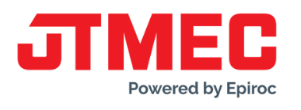
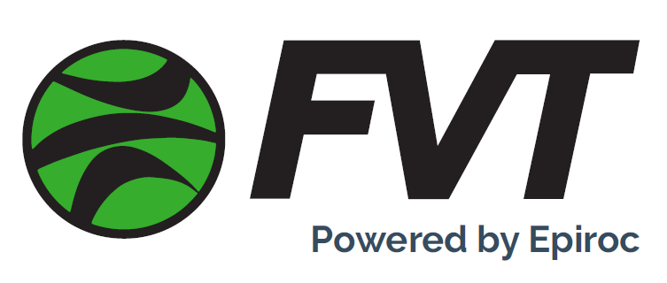
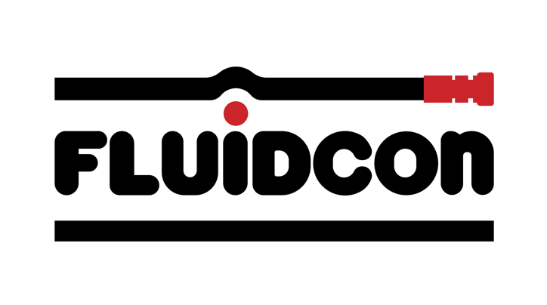
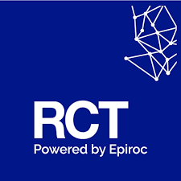
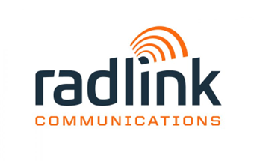
Epiroc brand portfolio (owned brands)
Accelerate the transformation
Unassociated brands
(No strategic fit with Epiroc brand positioning)
Associated brands
(in transit to become Epiroc brand)
Epiroc brand
(Master brand)
Non-compatible brand positioning
Brands to serve mixed fleet
Channels
Not yet PbE

Slide 4
Epiroc brand strategy
Building the power of Epiroc
1. Unassociated brands
(Non-strategic Epiroc brand fit)
2. Associated brands
(in transit to become Epiroc brand)
3. Strong Epiroc brand
(end goal)
As few as possible
As short time as possible
As attractive as possible
Notes:
To build the power of Epiroc, we
Maintain as few unassociated brands as possible – avoid dilution of management attention and resources. This means that there is a need for brand transition within this area and merge brands with each other to keep the portfolio as slim as possible.
Keep brands in transit for as short time as possible – again to avoid dilution of management attention and resources. A transition plan should be in place at the time of the acquisition.
Everything we do, is to make Epiroc strong, attractive and the shining star in our industry
Thank you!

Slide 5
Brand integration process
Creating a stronger Epiroc brand
Brand ready to become Epiroc?
YES
YES
NO
Brand integration process
Strategic fit with the Epiroc brand?
A
B
C
“Powered by Epiroc”
Measuring points for progress maturity
NO
Keep as unassociated brands
Notes:
Here’s an example on how our brand strategy works in practice:
Are there capabilities in Brand X that are needed to develop Epiroc into the future? Is there a strategic fit with the Epiroc brand?
If no, keep the brand separate and unassociated with the Epiroc brand
If yes, assess if the brand is ready to become Epiroc right away or
If a transition period is required to prepare for an integration – while ”Powered by Epiroc”. This is where we need to establish a process and how we measure maturity for each step on the way, to ensure that we channel the power into Epiroc while mitigating the risk of loosing speed, market/customers, personnel, or capabilities.

Slide 6
Why now?
Let’s have a look at our KPIs

Slide 7
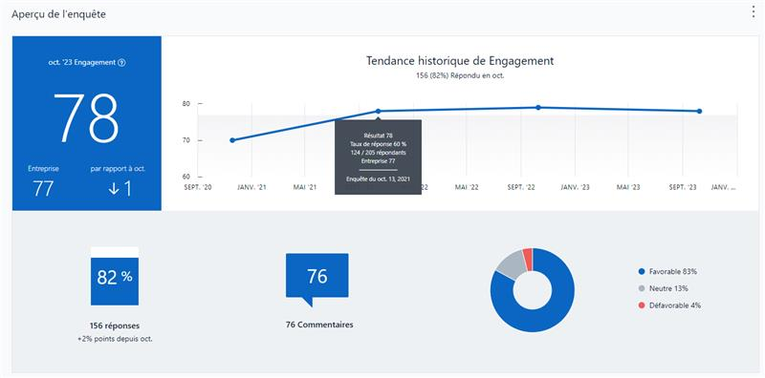
Key Performance Indicators
Internal
MyVoice Survey
The REX team has successfully maintained a high engagement score within our employee base over the last years.
Targeted Interviews
Our team has various concerns – both pros and cons towards the brand itntegration. As we raised feedback on the upcoming transition, here are some of the various positions we captured amongts the different geographical markets.
There are concerns about not being fully part of the Epiroc brand yet, which is causing some integration challenges all these years later
There is worry that clients feel that we loose the sense of dedication and expertise towards exploration

Slide 8
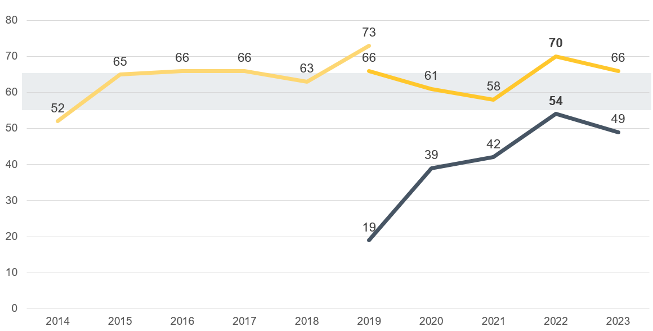
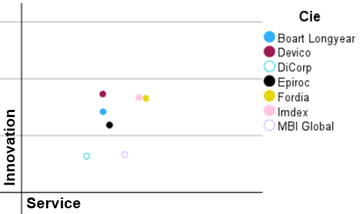
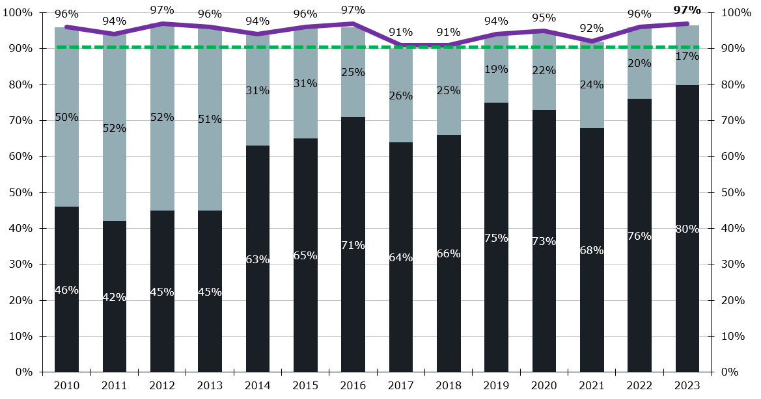
Key Performance Indicators
External
Satisfaction rate
We successfully maintained a high satisfaction rate within our customer base over the last years.
Net Promoter Score
We elevated the Epiroc NPS within our customer base significantly, but have reached a plateau in progression.
Brand Awareness and Perception
Our Canadian survey showed that the market perceives Fordia as more focused on exploration. We need to proceed cautiously with any change.

Slide 9
Our recommandation
Initiate branding transition in 2024
Our recommendation is to proceed with a comprehensive brand transition in 2024. Here are the key steps:
Embrace the Epiroc brand as the primary and overarching brand.
Retain the residual value of the Fordia brand by
Adapting our messages to prevent perception shift, emphasizing exploration as a key focus area for Epiroc as well as the relevant expertise from our team.
Using Fordia as a product trademark, to leverage knowledge for our diamond tools.

Slide 10
Brand transition stages
Organizing chaos

Slide 11
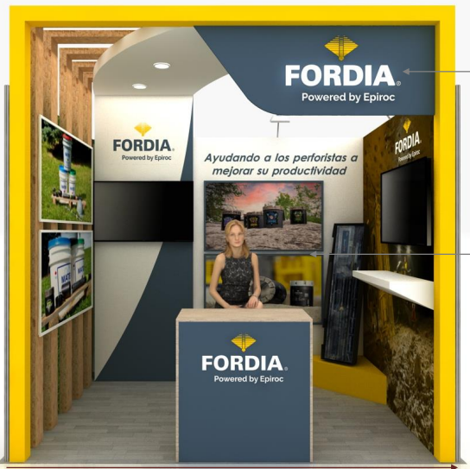
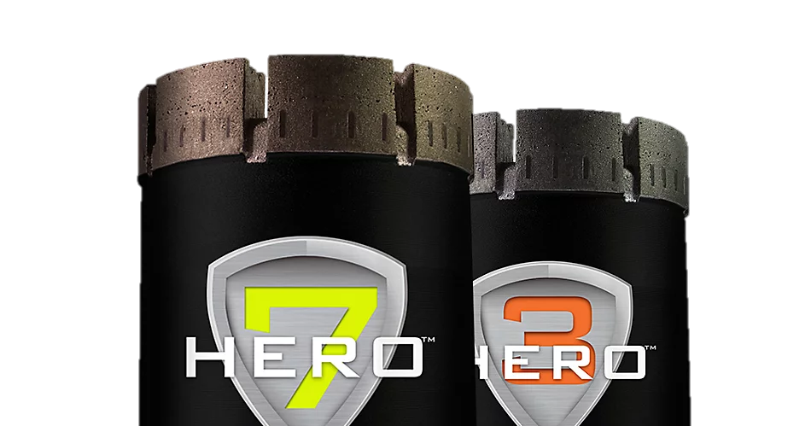
OBK Brand Transition
Examples of stages
Stage 1
Epiroc is shown as the umbrella brand. Associated brand is still presented, but with a lower focus.
Epiroc is the brand. Trademark products are part of the portfolio.
Associated brand has been implemented and is consistently used.
Stage 2
Stage 3
Exploration & OreBody Solutions
Exploration & OreBody Solutions
2019 - 2021
2022-2023
2024+

Slide 12
Next steps
What to expect

Slide 13
Upcoming changes
The 2024 timeline
Q1 2024
Employees now carrying Epiroc brand
Trade show strategy
Q2 2024
Onboard clients and partners (including an Ambassadors’ workshop)
Q3 2024
Continue digital transition by launching pages on Epiroc.com
Q4 2024+
Continued monitoring
New OBK guidelines for the Fordia brand and brand & comm package
Reconsider product packaging strategy, internal news update and social channels
Update brand assets, including product packaging outside of diamond tools
Start digital transition with structure and initial content (web and socials)
Continue to update brand assets (including translation)
Monitor brand perception and KPIs
Trucks
Review internal communication channels
Buildings, combined with local celebration events in Canada
Update merch
Boxes and tape
Legal documentation, including contracts and SAP
Templates
Web OBK landing page
Hard cut-off for Fordia on anything else other than DT
Identify required liquidation (stickers, boxes, etc.)
Employer branding update (including contracts)
Revisit product naming (rods, etc.)
Employee uniforms
Mostly internal visibility
Internal and external visibility
Task force committee to monitor brand transition progression via quarterly meetings :
Brian Doffing, Sara Paquet, Anna Dahlman Herrgard, Annie Lévesque, Laëtitia Banfi, Marc Paquin & Julie Massé

Slide 14
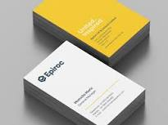
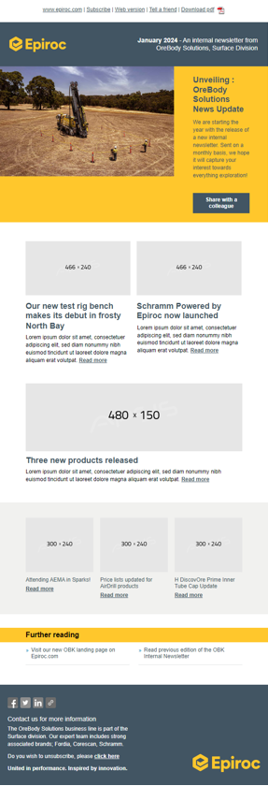
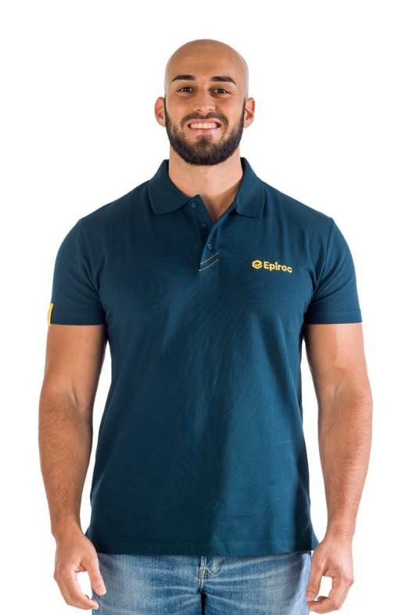
Internal Communications
The 2024 timeline
Employee to carry the Epiroc brand
Emails and email signatures
Business cards
Employee apparel and uniforms
Trucks
Implementation of a monthly OBK News Update
Implementation of the OBK section in the Surface Sharepoint
New OBK guidelines for using the Fordia trademark

Slide 15
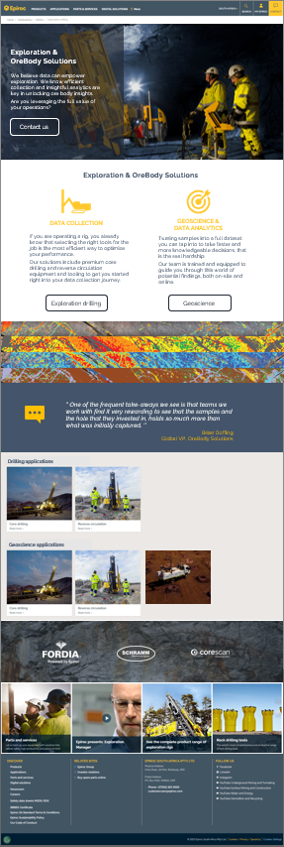
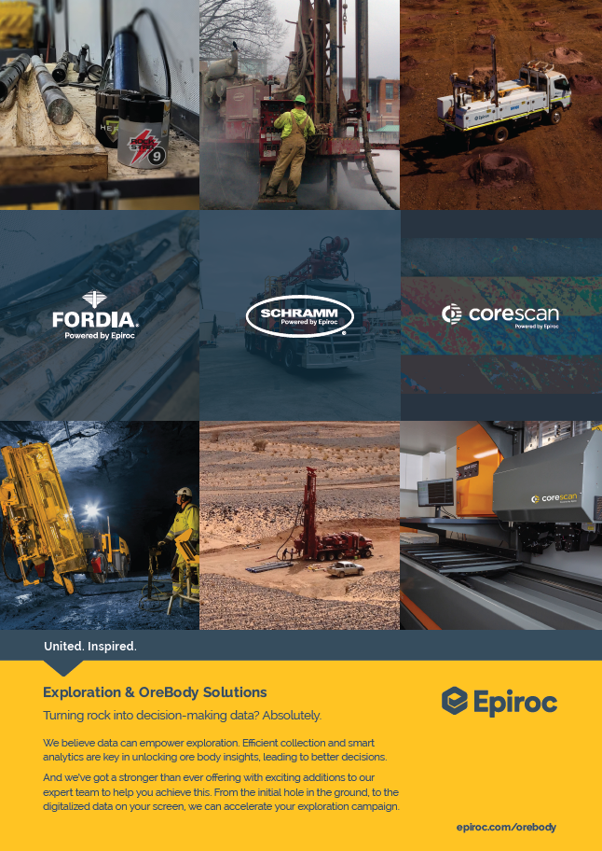
External Communications
The 2024 timeline
Campaign to onboard clients
Buildings
Web site
Update assets and create new required ones
Catalogue, Technical documents, Guides, Instruction manual, etc.
Trade show strategy
Ad material
Packaging – except diamond tools, to be reviewed in 2025
Social media channels
LinkedIn, YouTube, Instagram, Facebook

Slide 16
Where will the Fordia brand remain?
The 2024 timeline
On diamond tools!
On a lighter fordia.com web site
On a given area within an Epiroc booth
On focused but limited promotional tools (ad, video, etc.)
Potentially via Facebook, through a network of ambassadors
HERO, RockStar, Viking and other product names…
Will continue to be on the packaging of diamond tools
Could be part of a focused promotional tools (ad, video, promo items, etc.)

Slide 17
Getting started!
To-do
Approve plan
Communicate plan to the global team
Attend production meetings
Host Teams sessions
OBK Newsletter
Enkourage + Attractive screens
With the help of the team, list all the sub-categories of elements we need to update, create a SmartSheet file or filter in the current OBK B&C sheet, to track progress
Form the Committee and book sessions
Rock ‘n Roll!

Slide 18
Questions?

